Slide 1
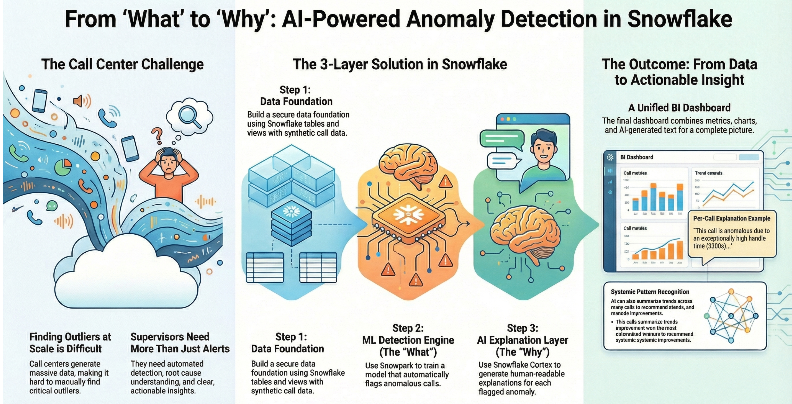

Snowflake Prototyping
Loy Sikdar
2025

Slide 2
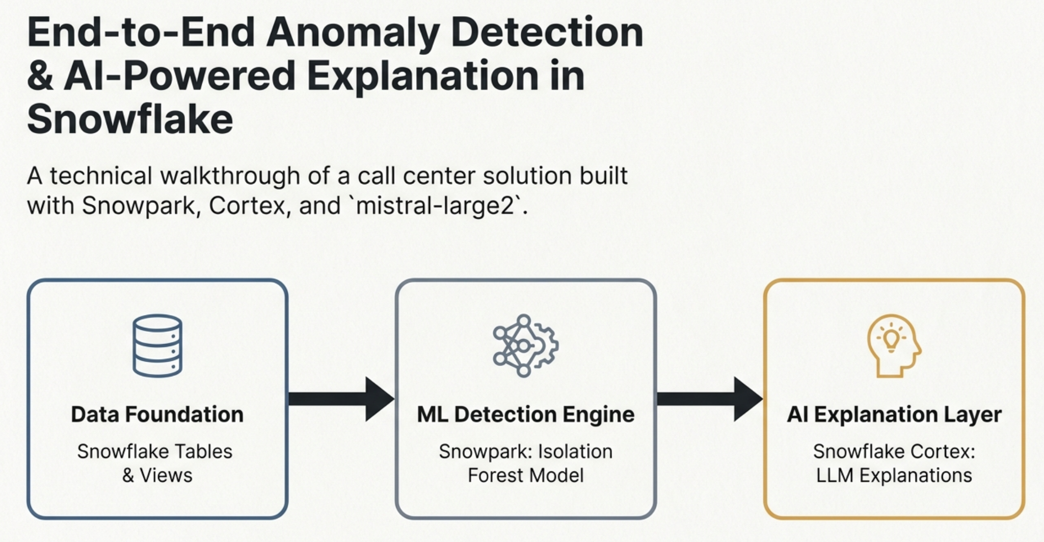

Slide 3
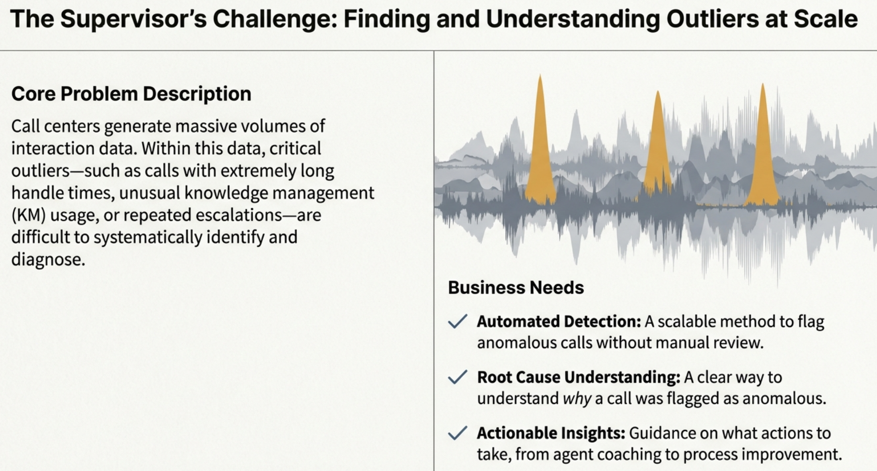

Slide 4
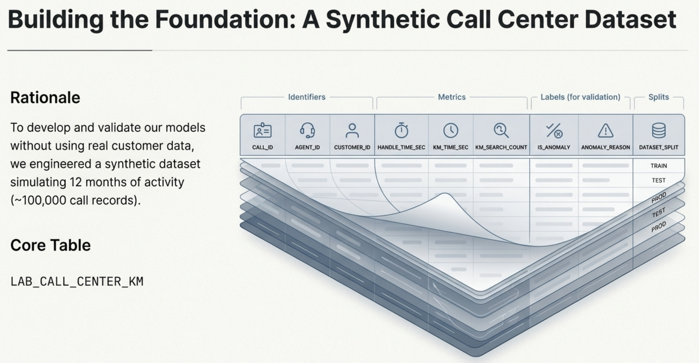
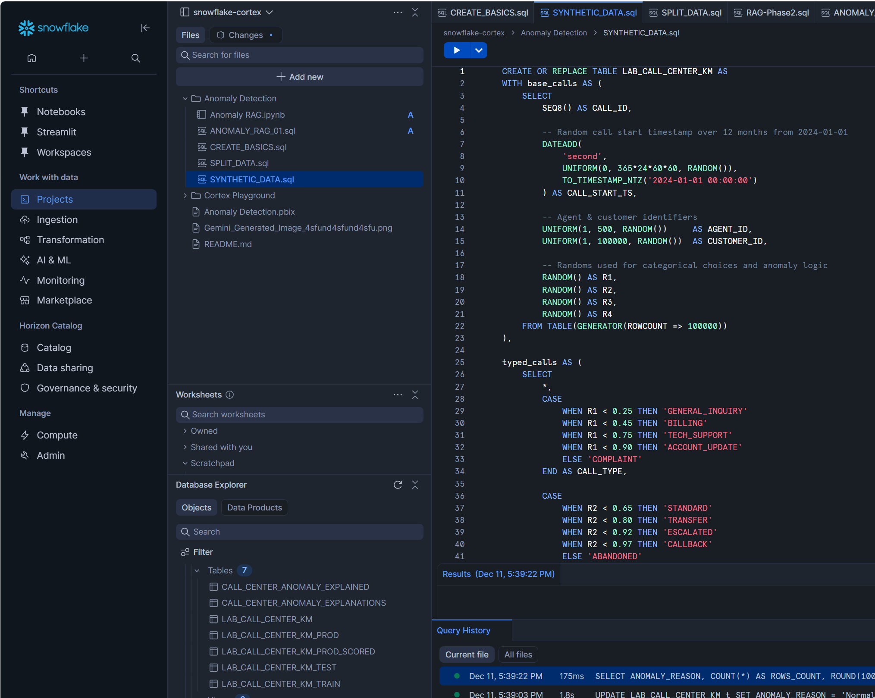

Slide 5
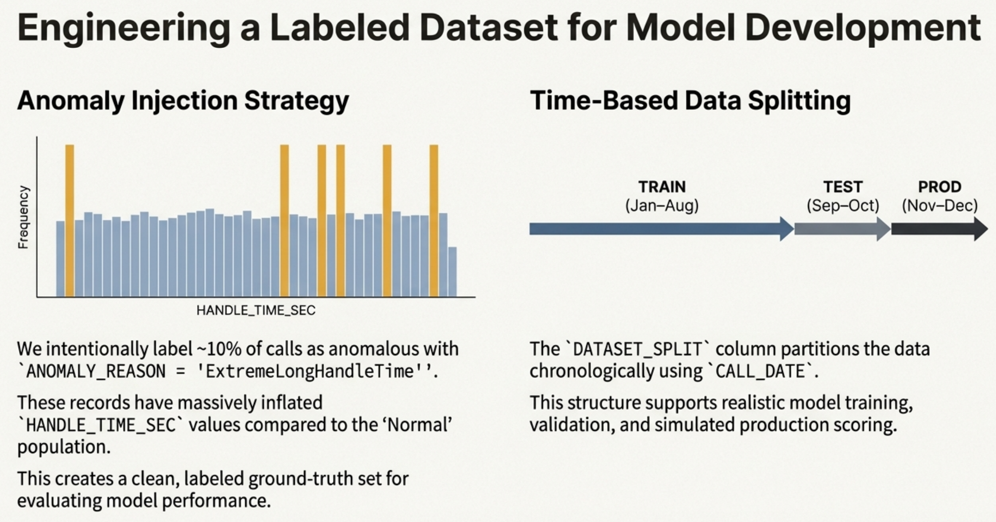
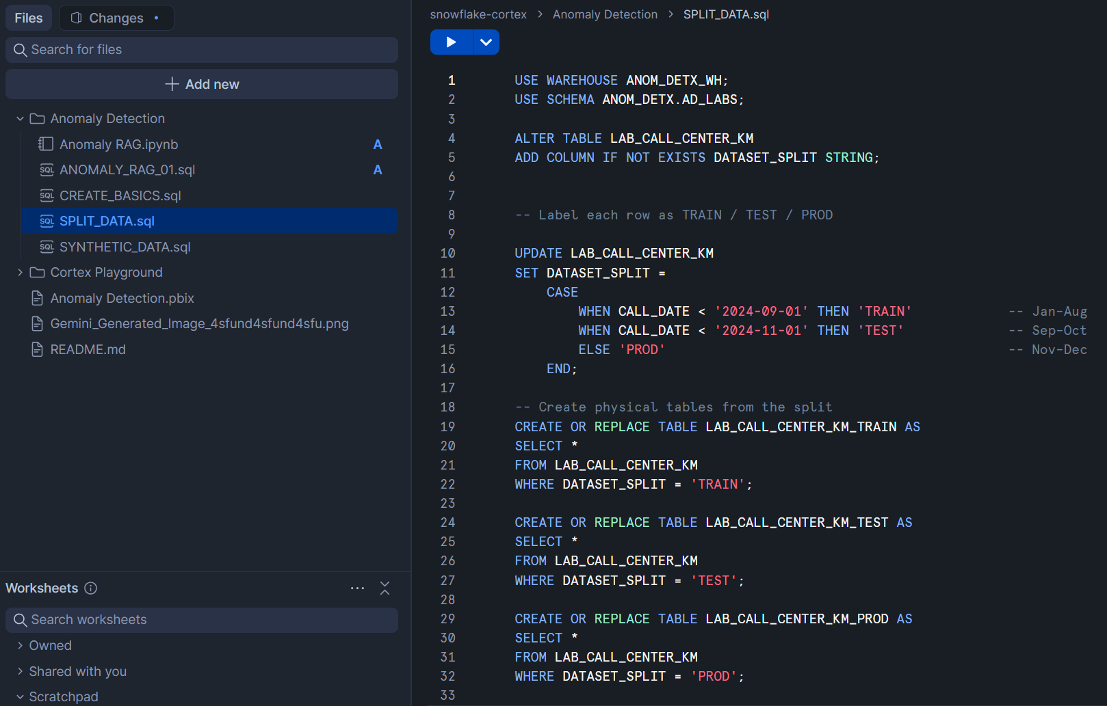

Slide 6
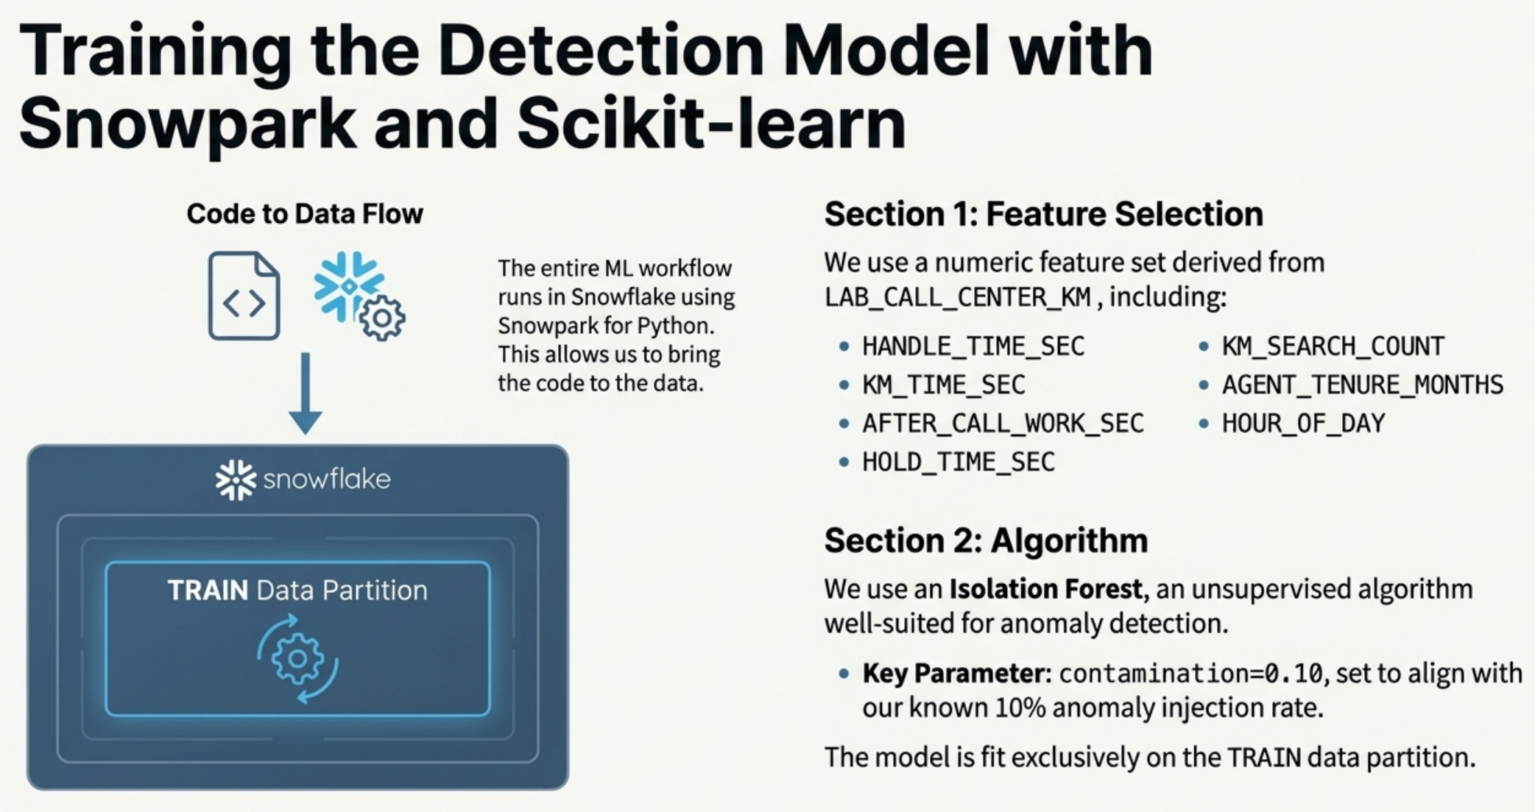
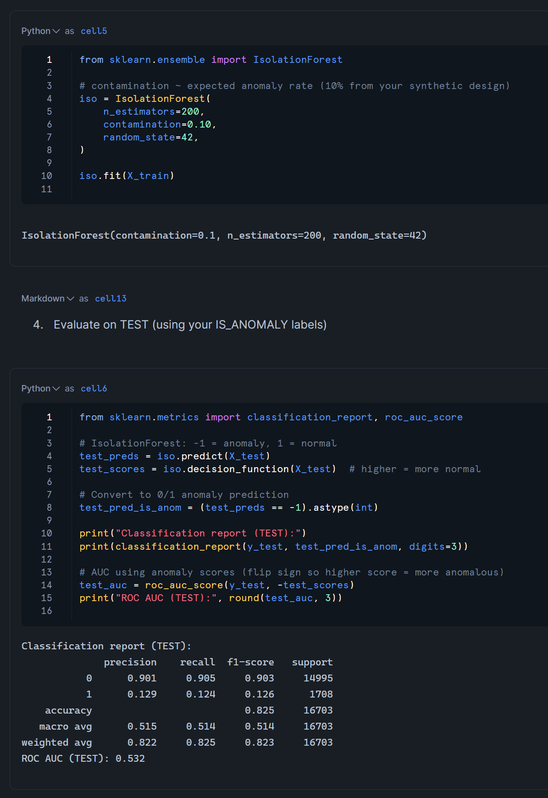

Slide 7
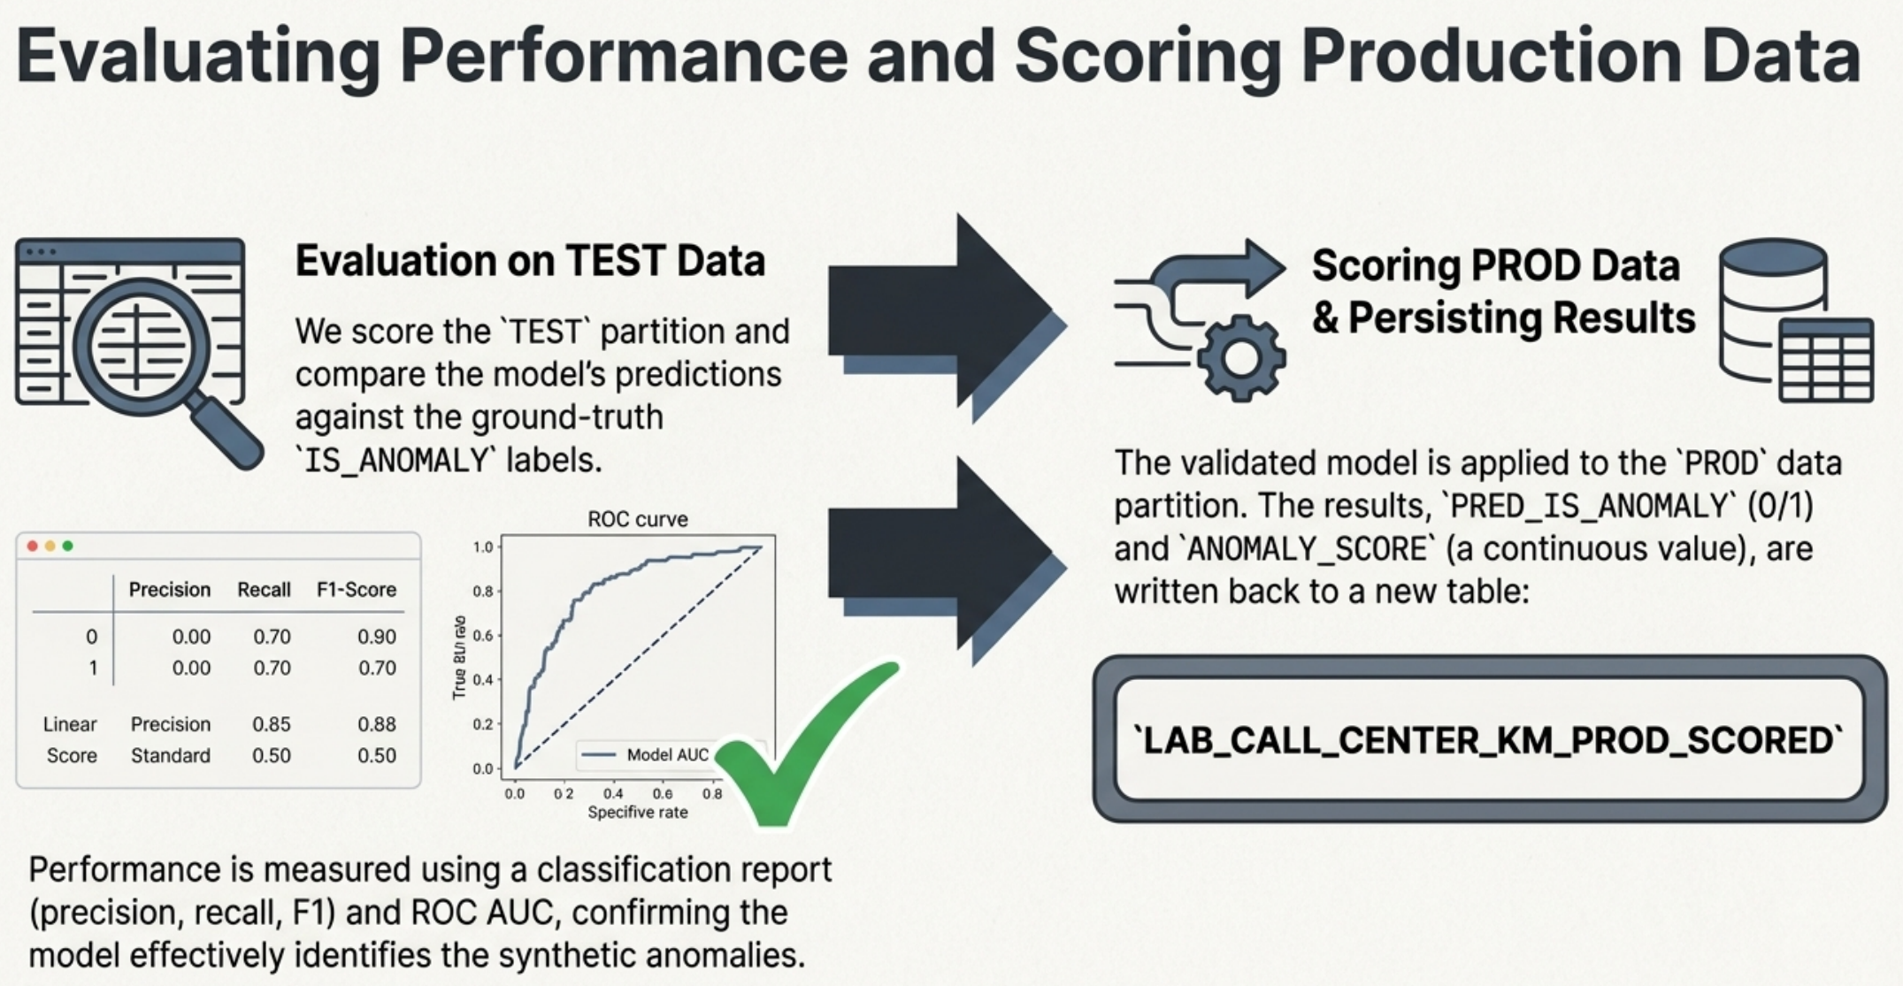
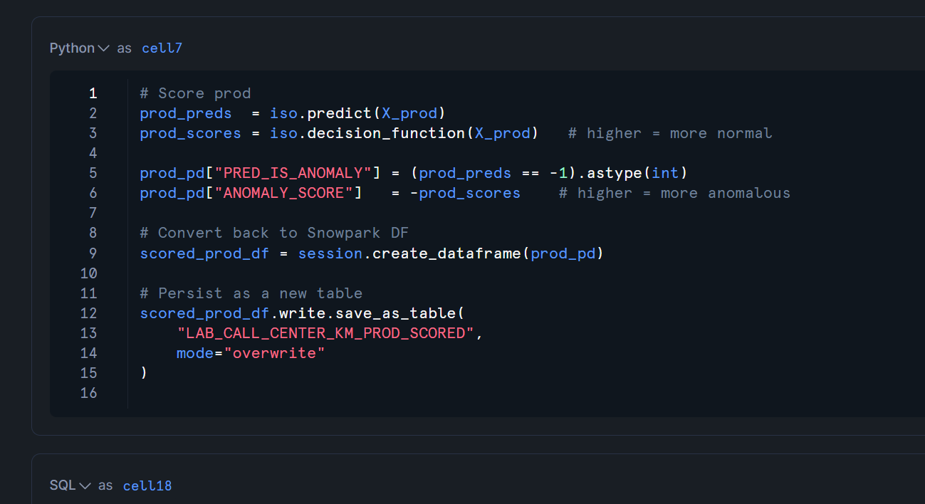

Slide 8
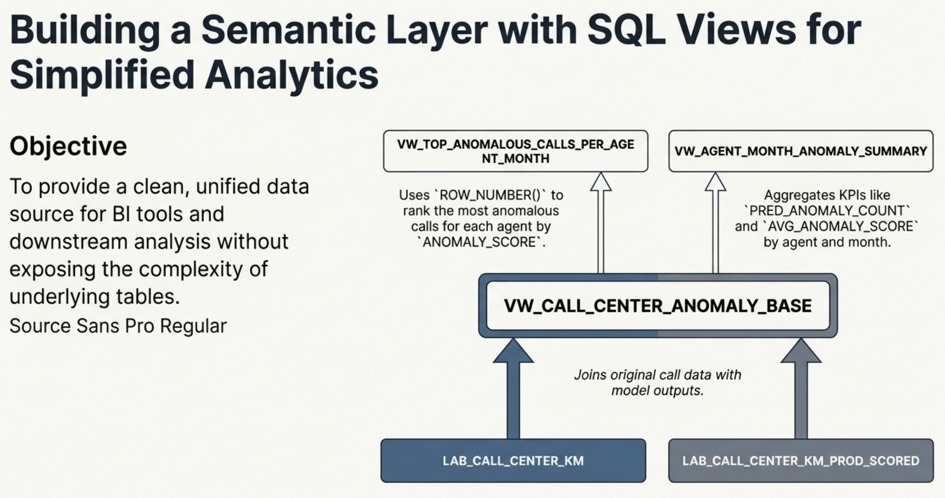
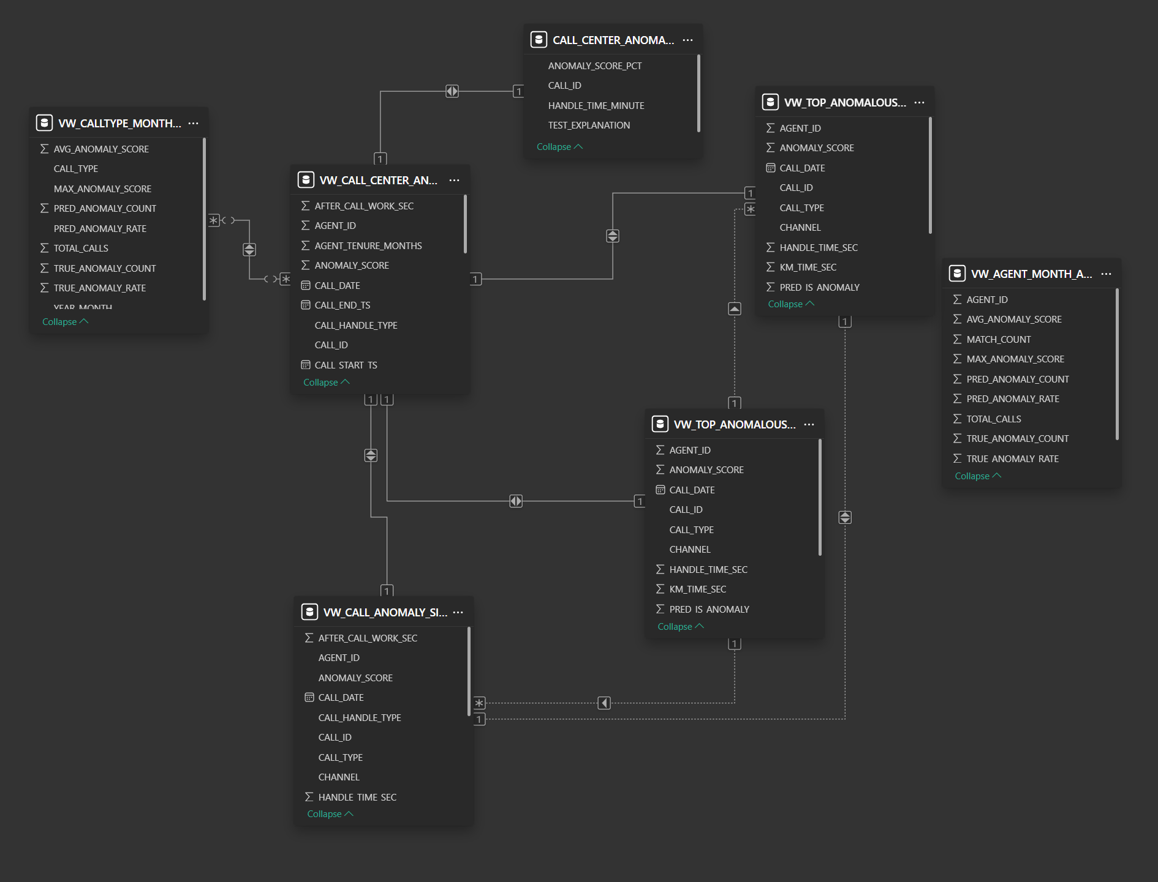

Slide 9
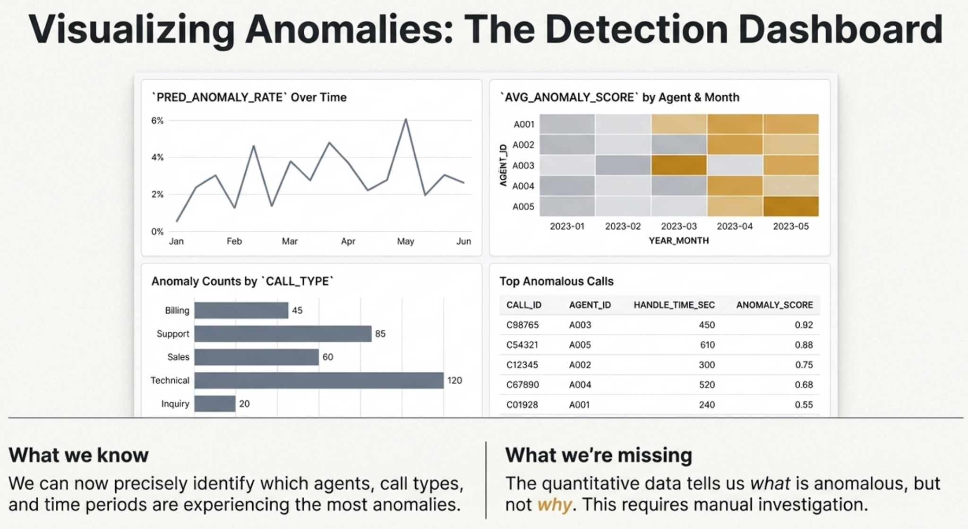

Slide 10
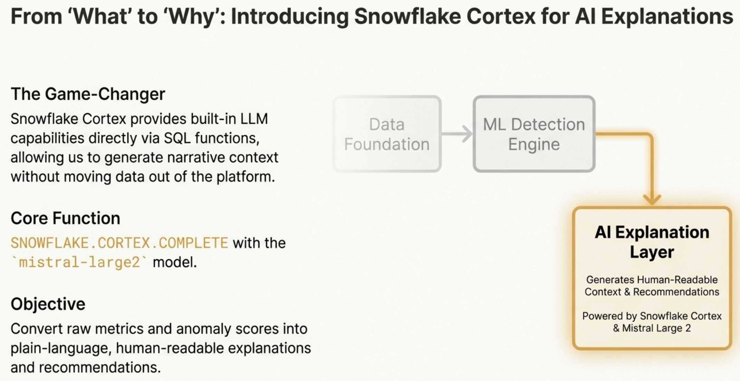

Slide 11
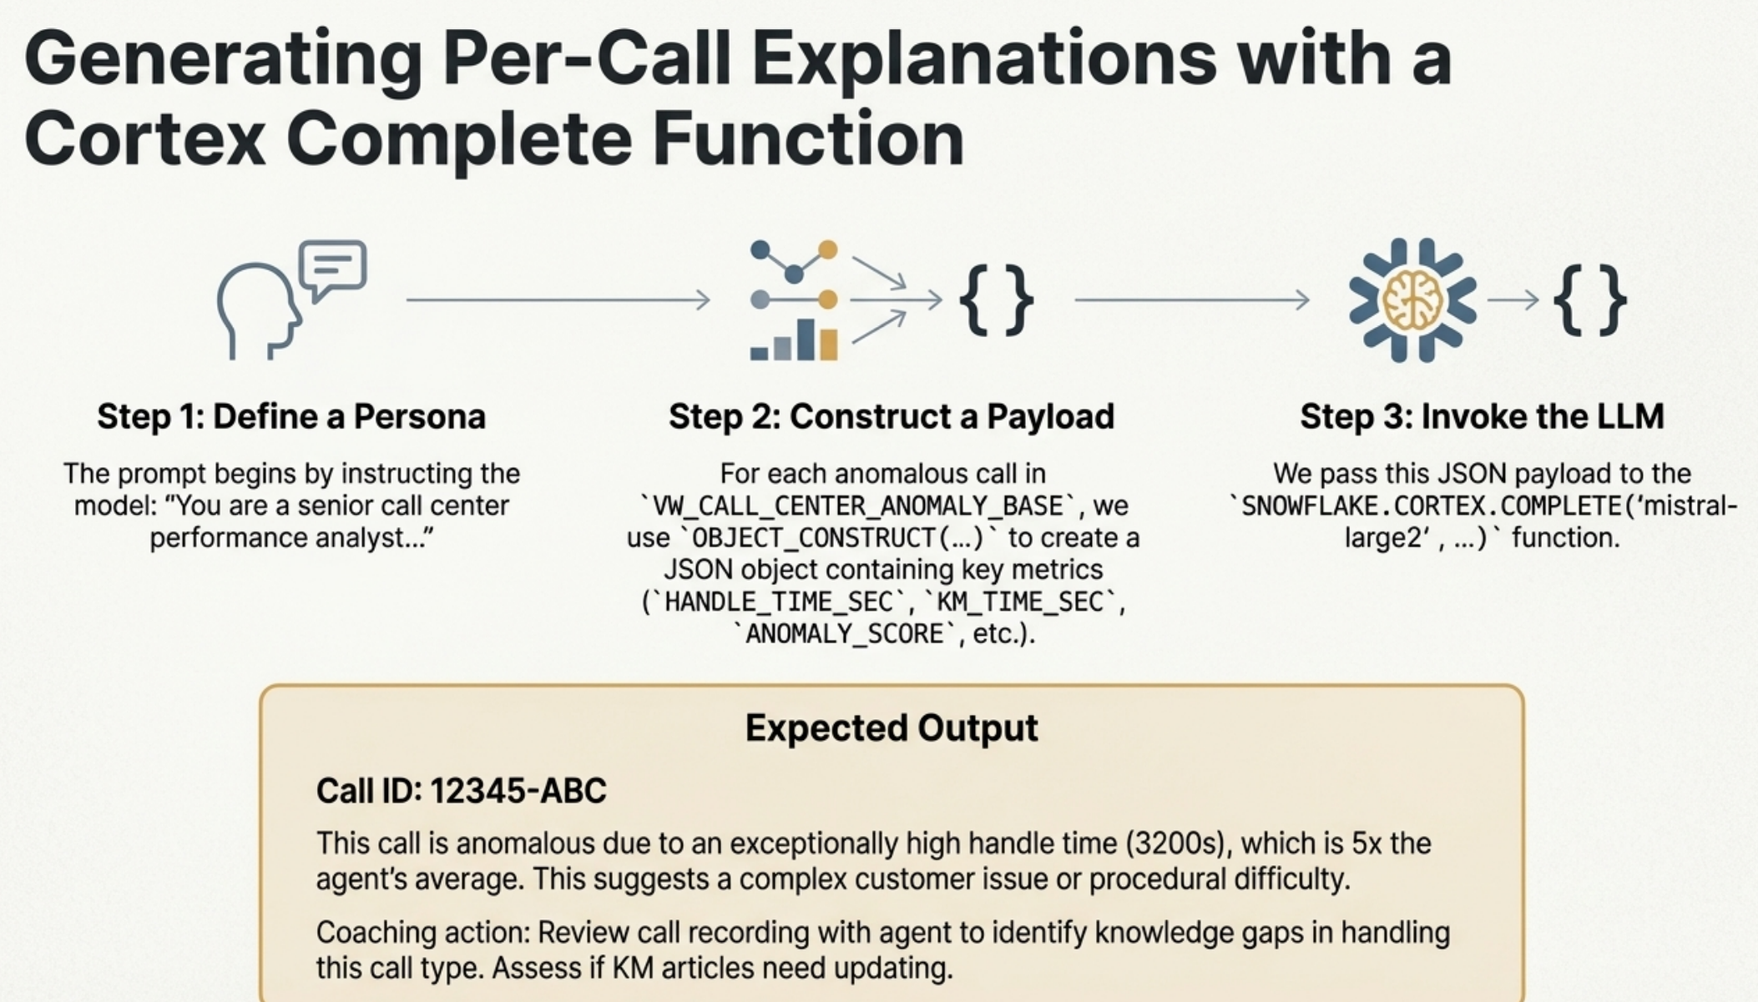
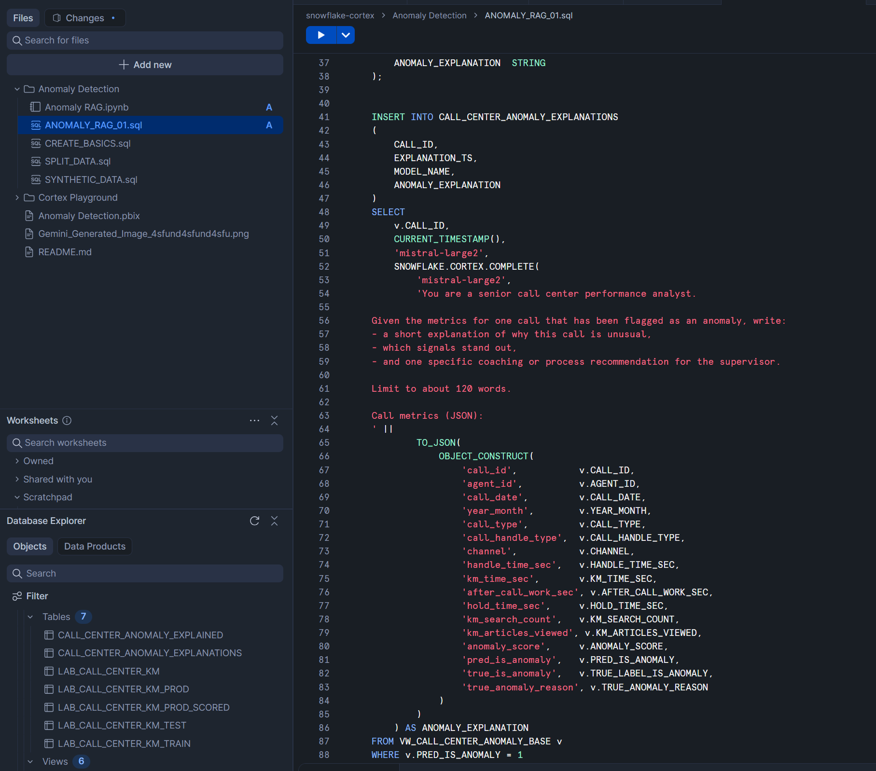

Slide 12
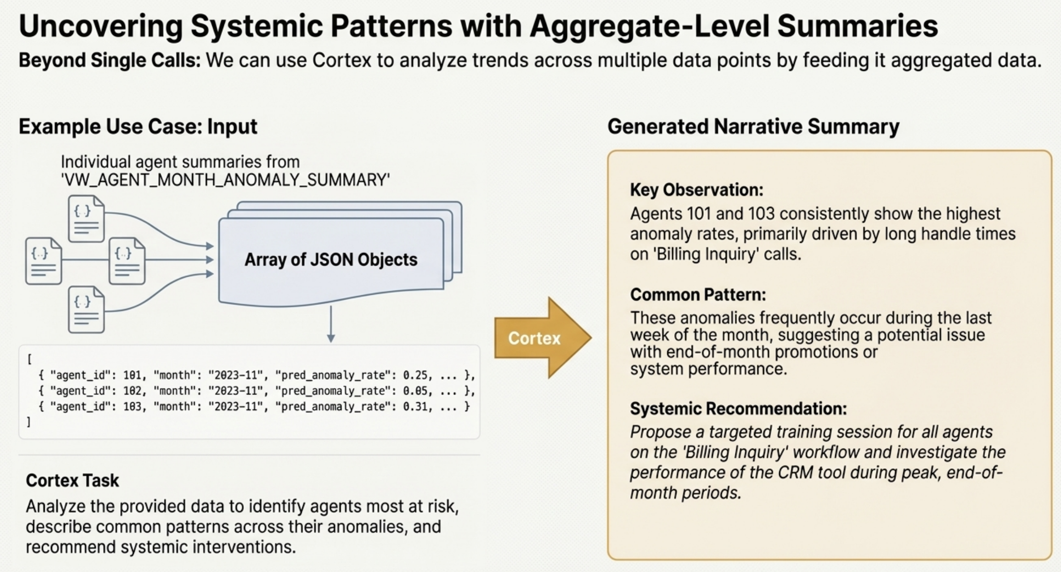

Slide 13
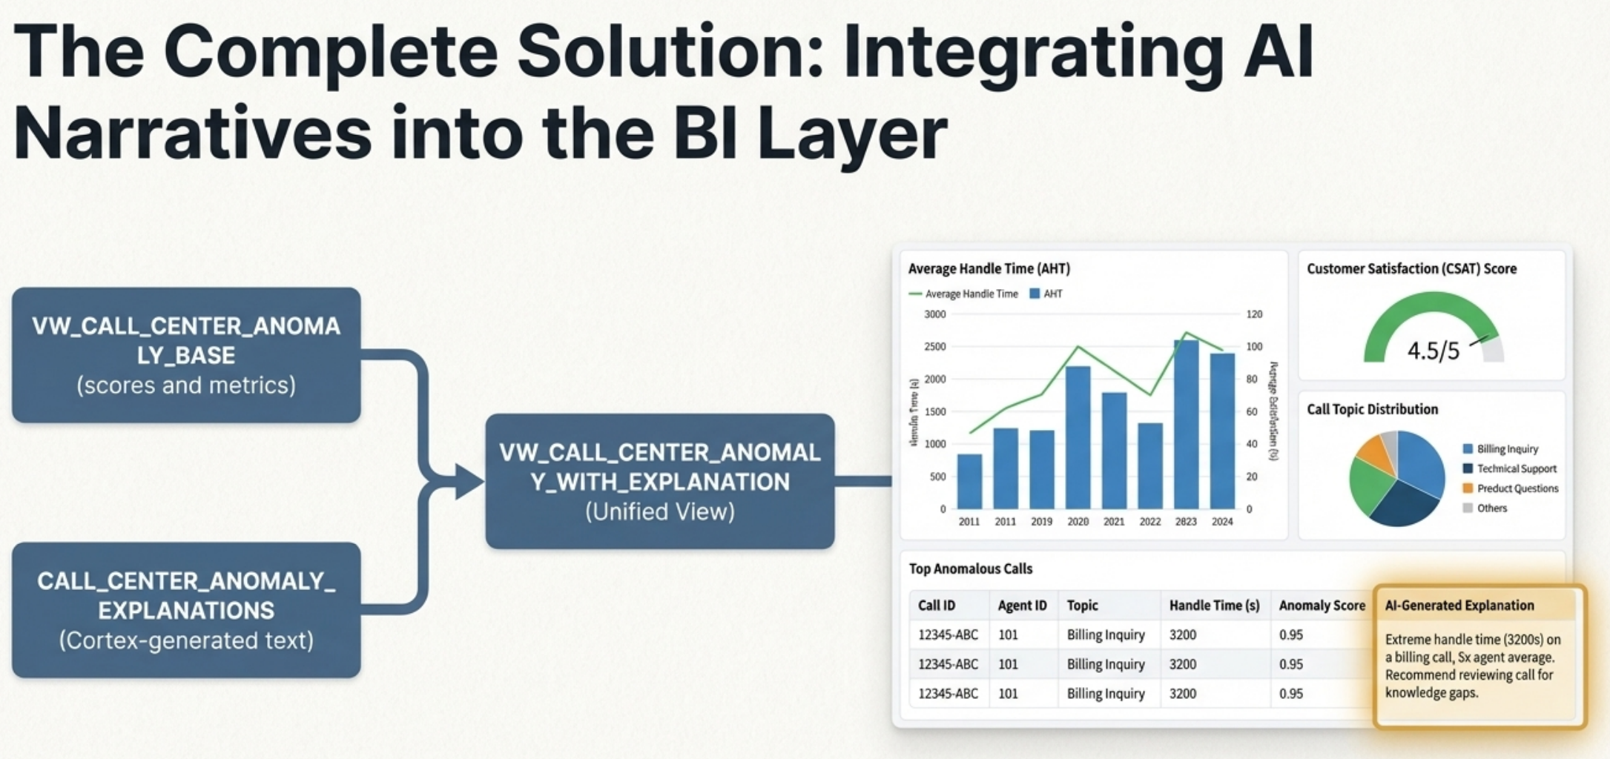

Slide 14
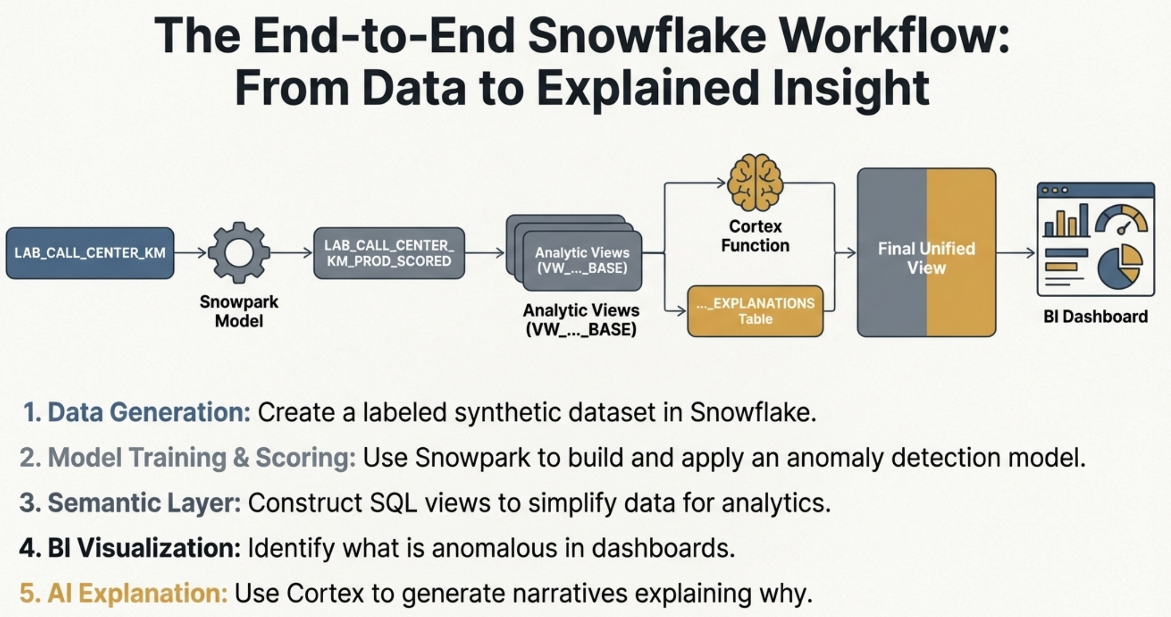

Slide 15
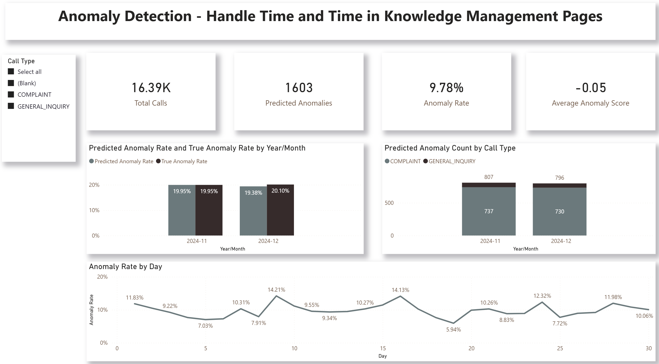
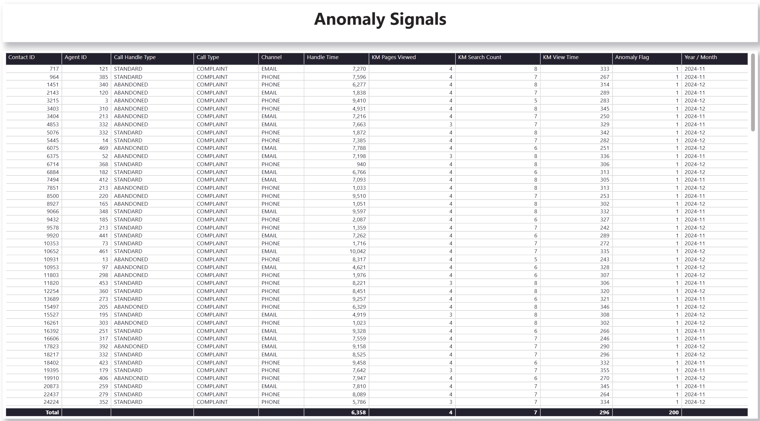
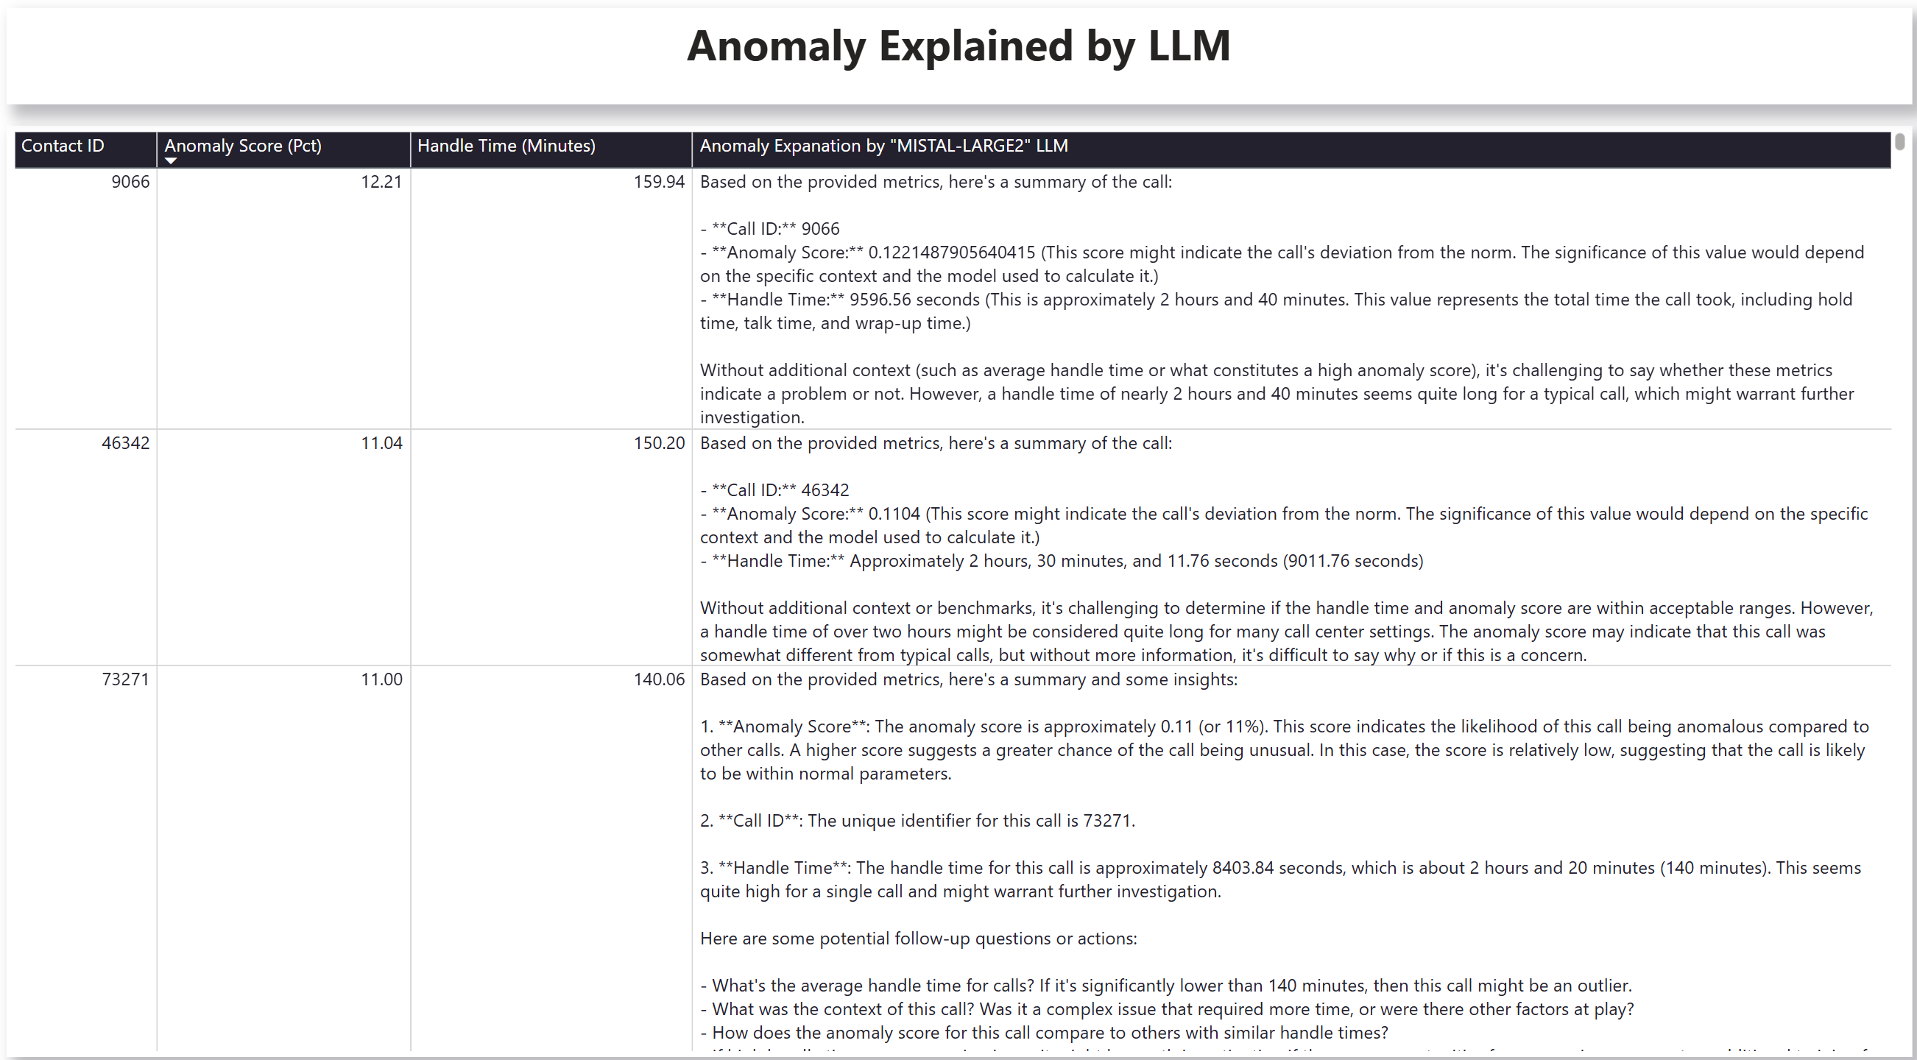
Prototype Dashboard

Slide 16
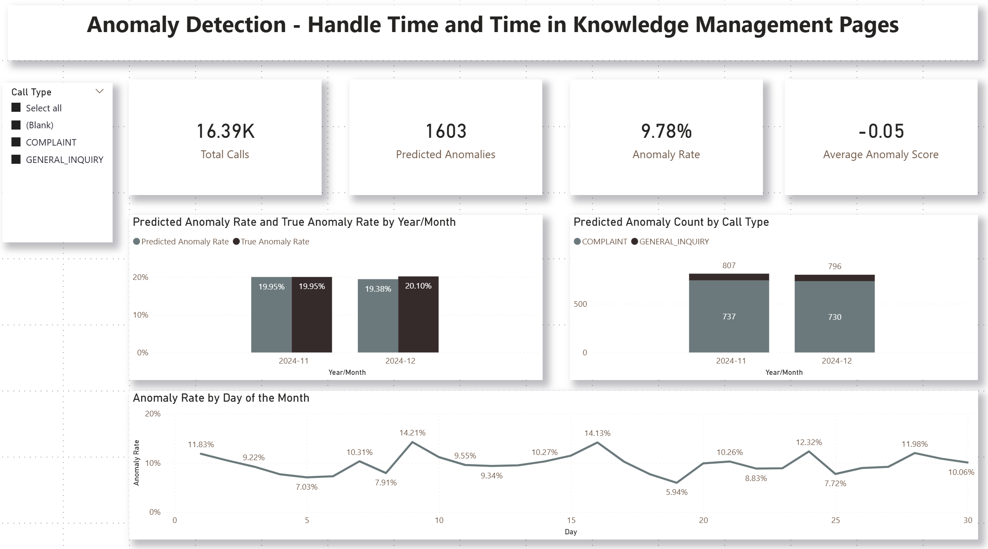

Slide 17
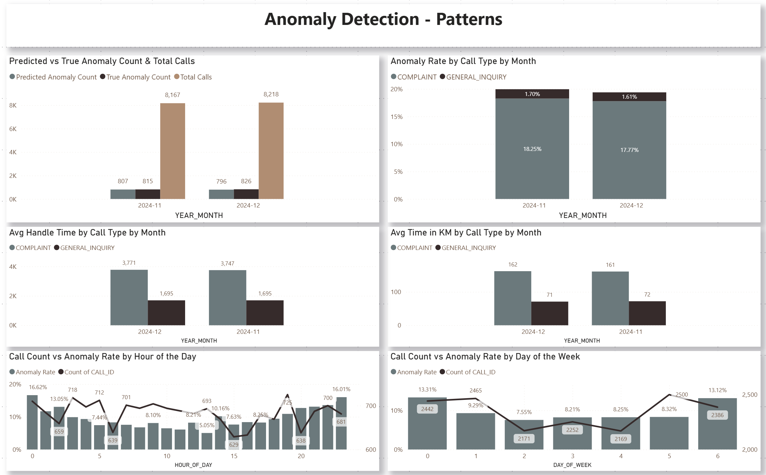

Slide 18
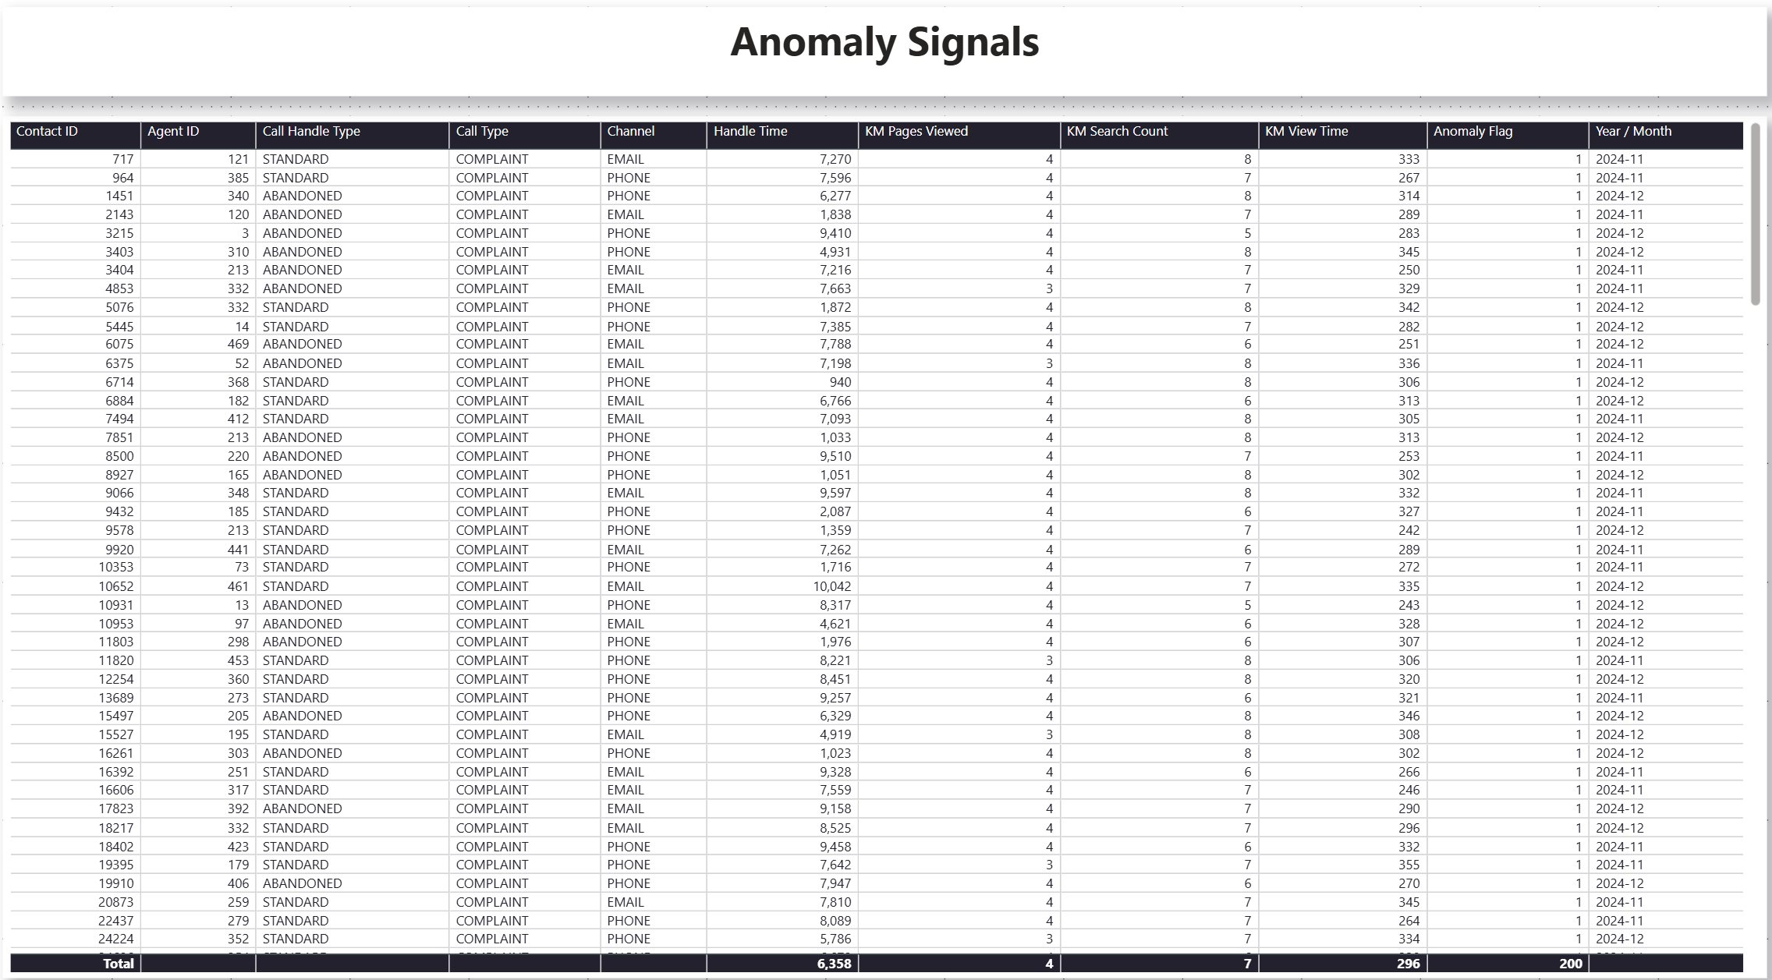

Slide 19
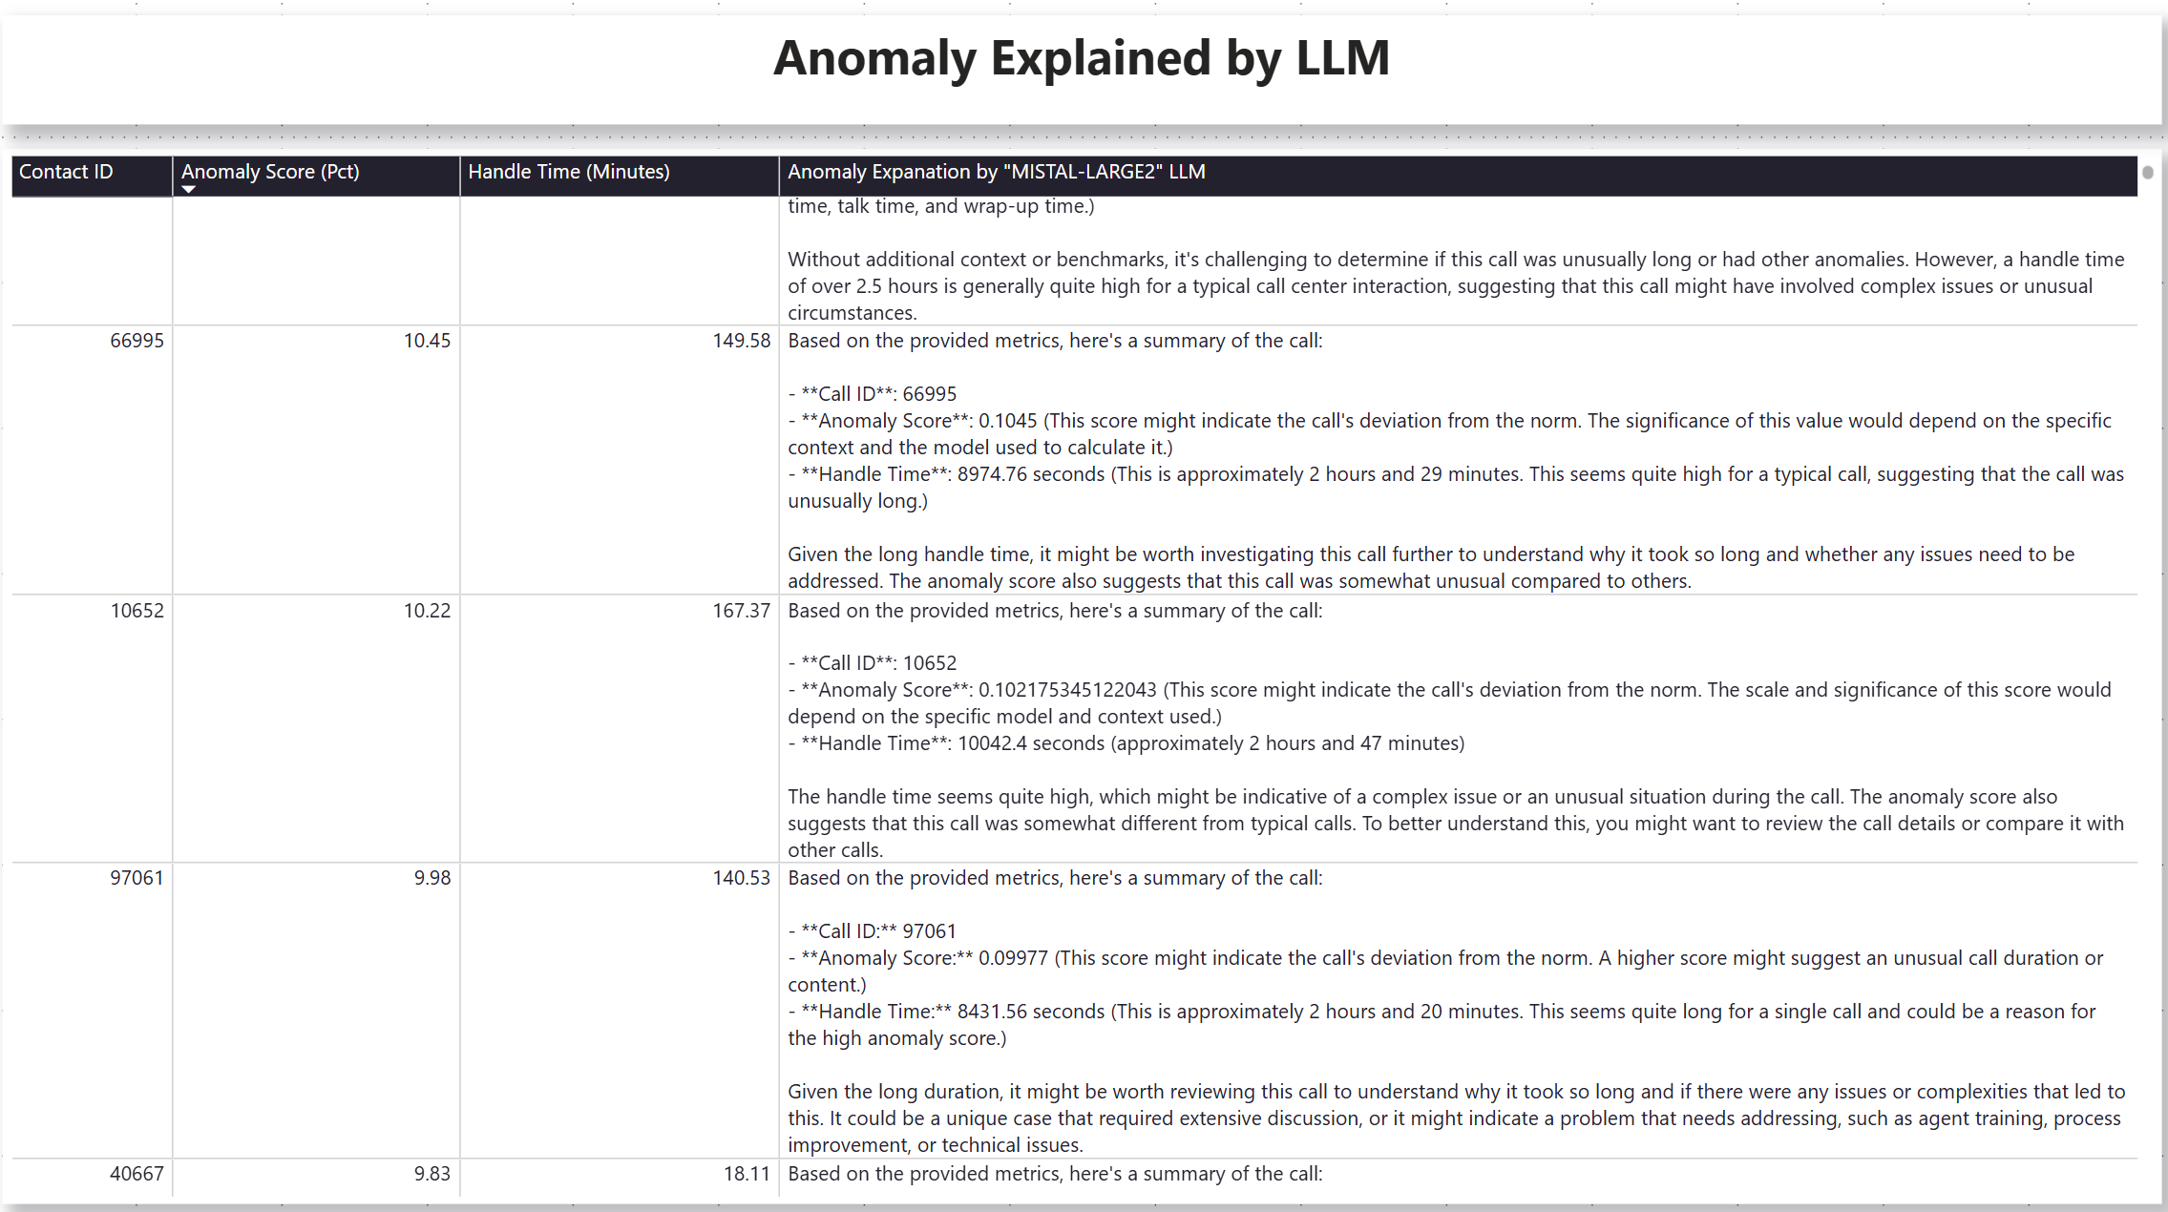

Slide 21
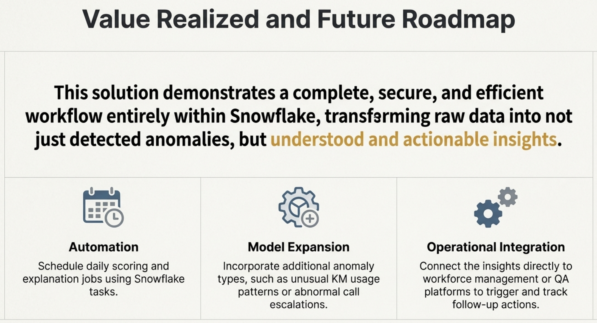

Slide 22
Features and Capabilities needed for the prototype
A. Compute & Language Capabilities (Snowpark)
Feature: Snowpark for Python enabled on specific warehouses.
Privilege: Ability to run Python user-defined functions (UDFs) and stored procedures.
Justification: We need to run data science workflows (using libraries like scikit-learn and pandas) directly where the data lives. This is required to train models (e.g., Isolation Forests) without the security risk and latency of exporting data to external servers
B. Generative AI & LLM Access (Cortex)
Feature: Snowflake Cortex functions (specifically SNOWFLAKE.CORTEX.COMPLETE).
Privilege: Access to use Large Language Models (specifically mistral-large2) within SQL queries.
Justification: This allows us to convert raw numerical scores into human-readable narratives. We can programmatically generate explanations for business anomalies (e.g., "Why was this call flagged?") directly within the database
C. Data Engineering Independence (Sandbox Schema)
Feature/Priviledge: CREATE STORED PROCEDURE, and CREATE TASK privileges within a designated "Lab" or "Sandbox" schema (e.g., ANOM_DETX.AD_LABS).
Justification: Logic Encapsulation and Automated scheduled

